Slide 1

Pixabay
For Free Images

Slide 2

Add Images To Favorite
You can show all descriptions about the image you want

Slide 3

Download Images
You can download the image on your device and use it offline.
We use permissions to use internet and access your storage to be able to download the image on your device

Slide 4

Search
You can search about the category of images you want like animals, cities,..
You will find animations to show you if this category has images or not.

Slide 5
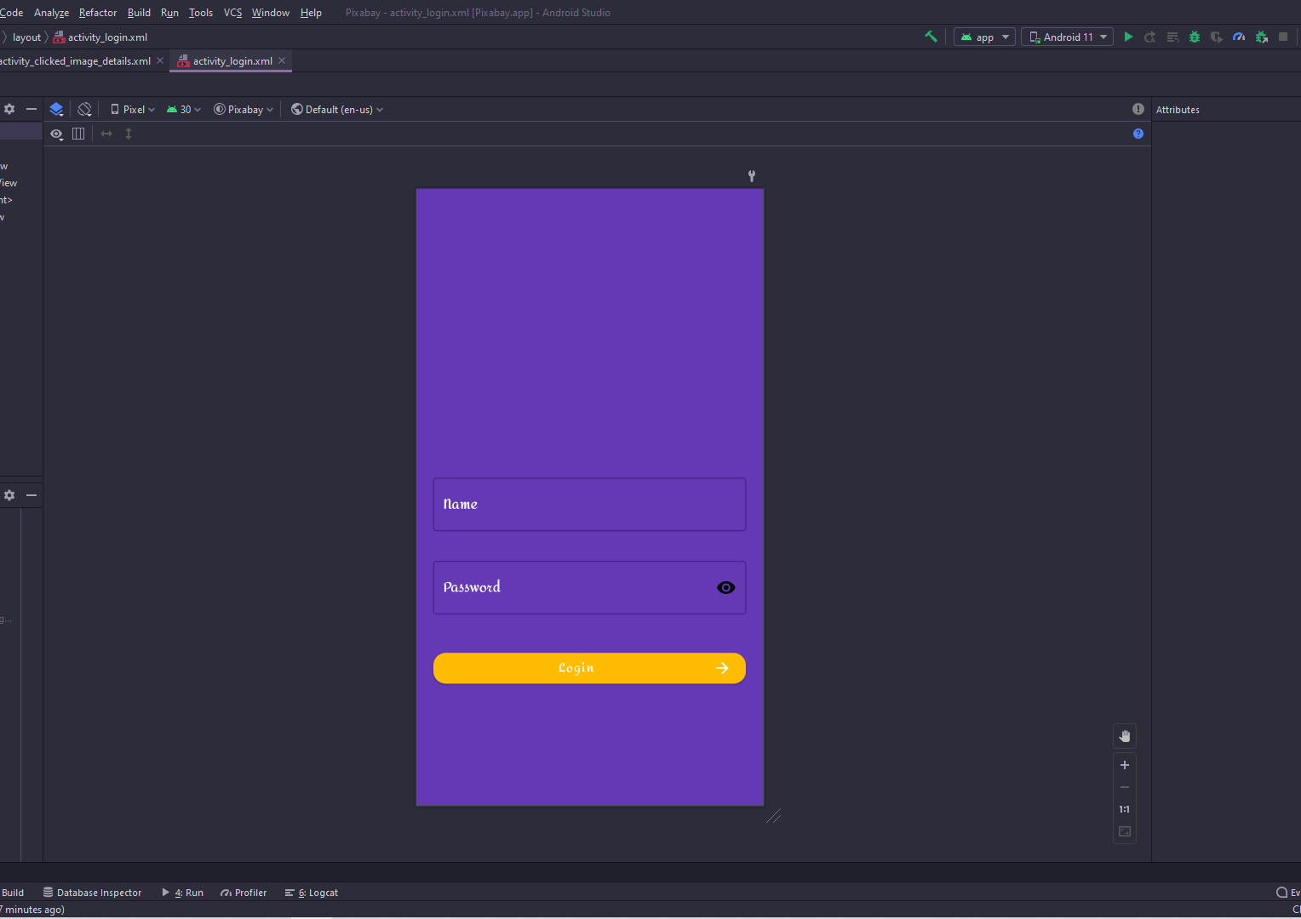
Login Activity
The first activity is the login activity to enter your user name and password.
At the first time only then the program will save the user name and the password on the shared preferences and put the data into the views you just login.
At the top we put animation to feel happy when you use the application

Slide 6
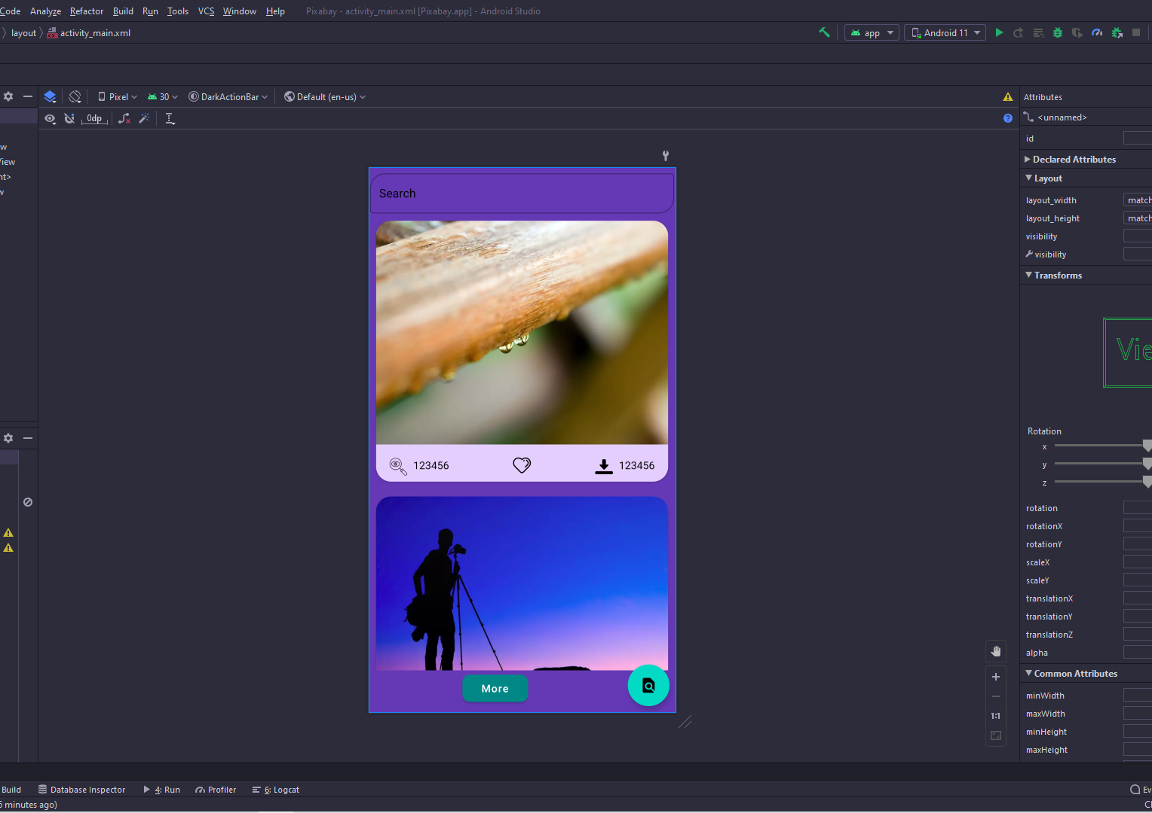
Main Activity
The main activity contain four views and toolbar
The first view is EditText to search about any category you want.
The second is the RecyclerView to show all the images that get from the server.
The third view is the Floating Action Button to search.
The last view is the Button to show more images.

Slide 7
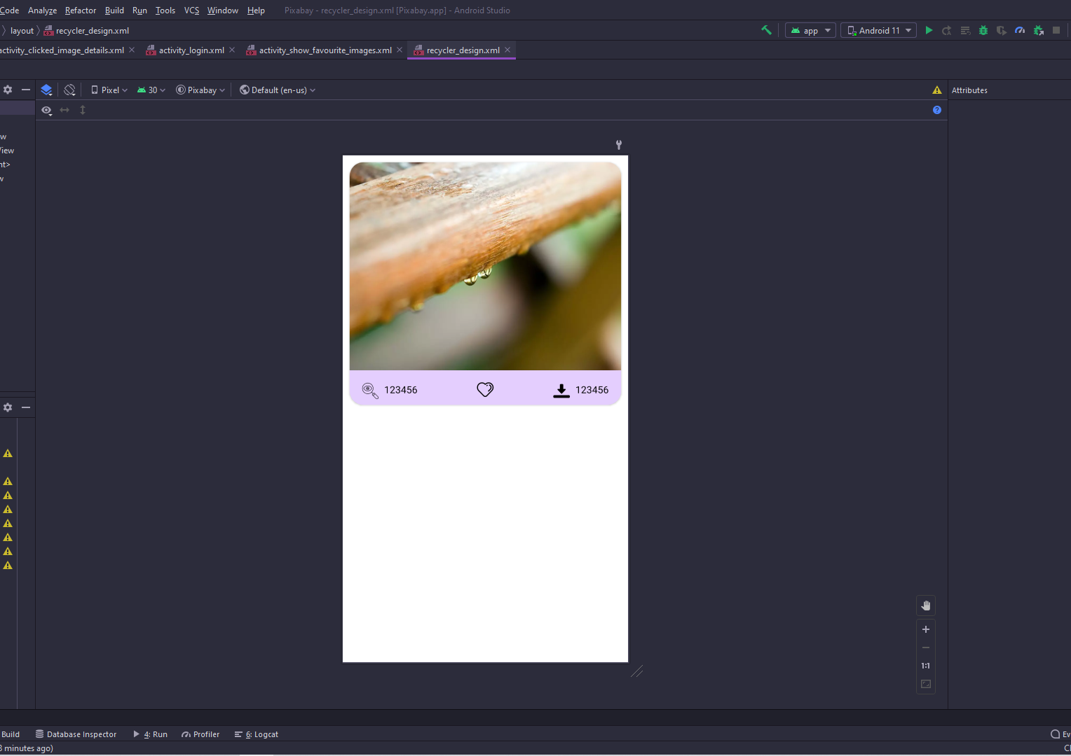
Recycler Design
We use CardView to show the data then we put LinearLayout with orientation vertical and put ImageView
Then we put another LinearLayout but the orientation is Horizontal and put three view the first is TextView with Drawable at Start to show the number of views.
Then we use ImageView To be able to add this image to the favorite or database.
The last view is the TextView with Drawable at start to show the number of downloads.

Slide 8
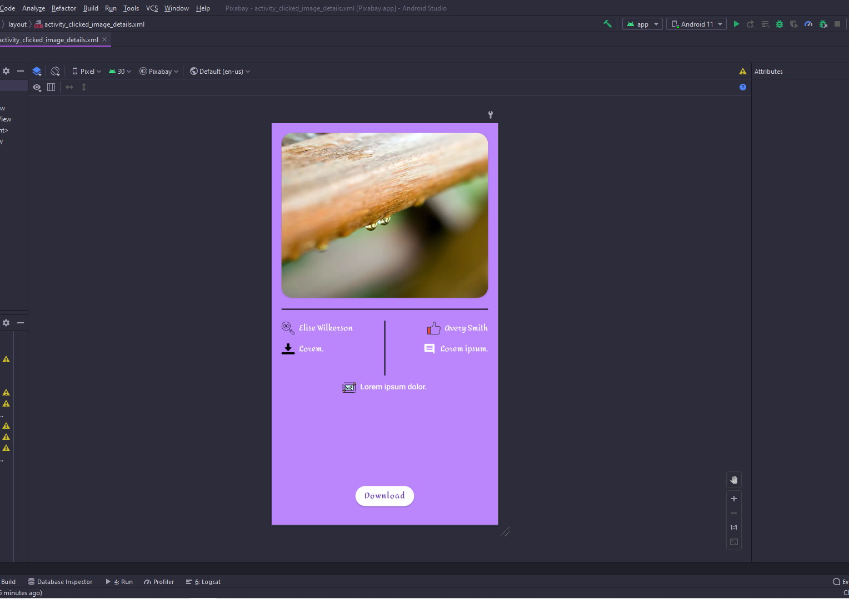
Detail Activity
This activity to show the details about the image you click.
And has the button at the end that can download the image at your device.
And also show the size of the image.

Slide 9
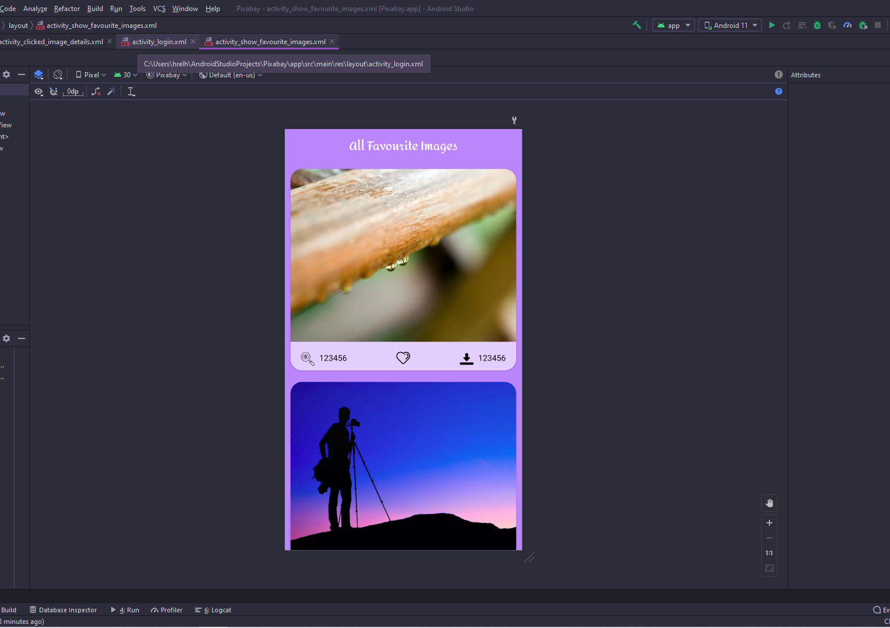
Favorite Activity
This activity to show all images on the database you add by clicking on the heart image

Slide 10
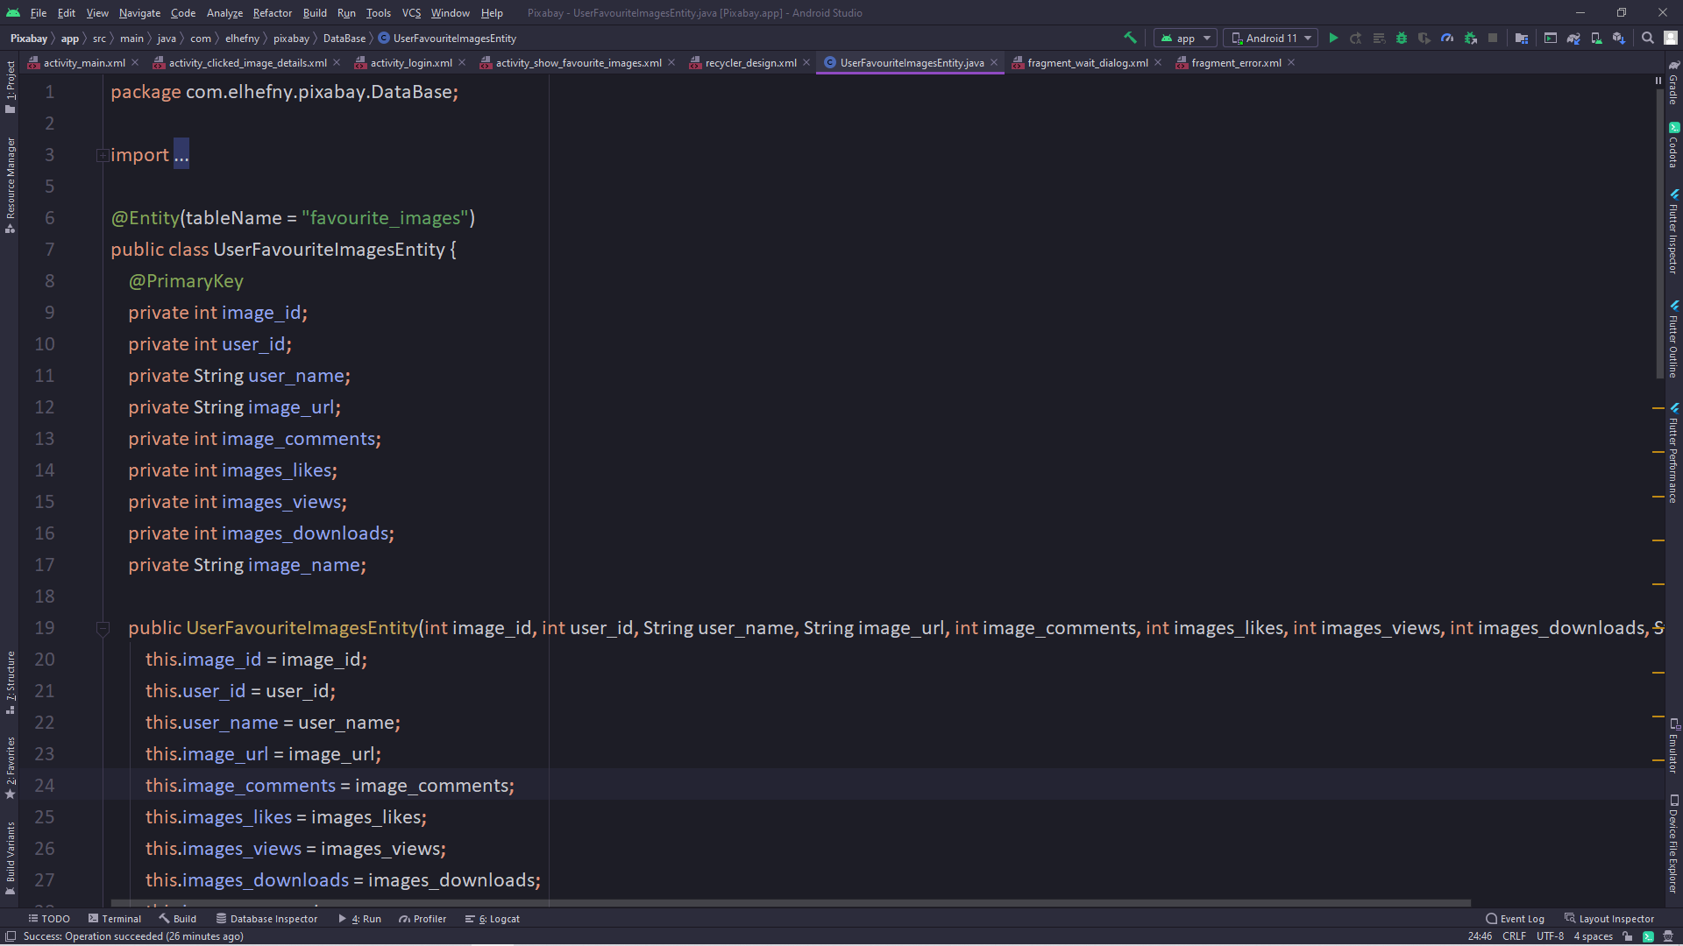
User Favorite Image Entity
We add the image id and user name to be able to find all images that the user added , if the user change the data of the previous user didn’t show

Slide 11
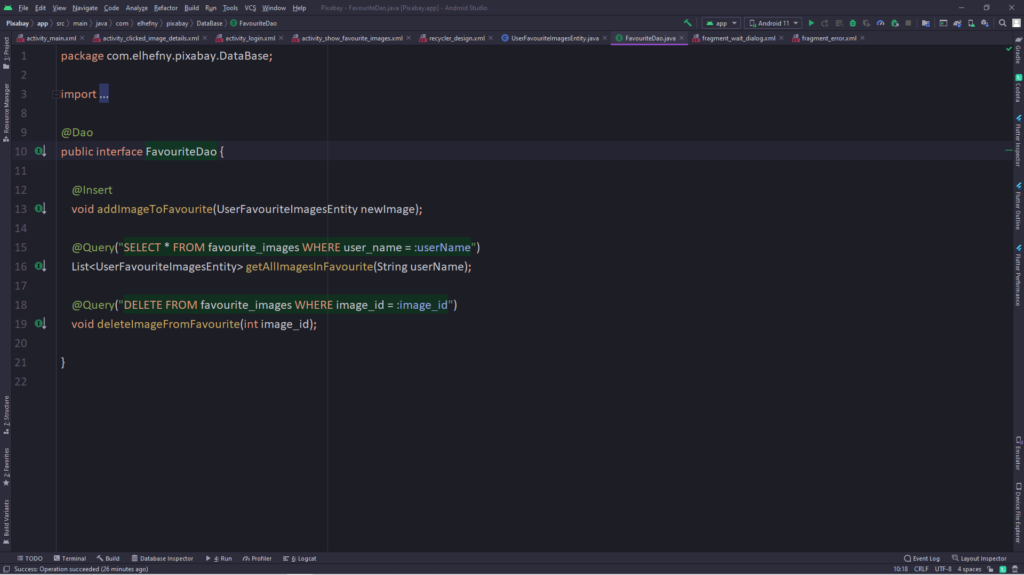
Data Access Object
Here we write all queries that deal the database

Slide 12
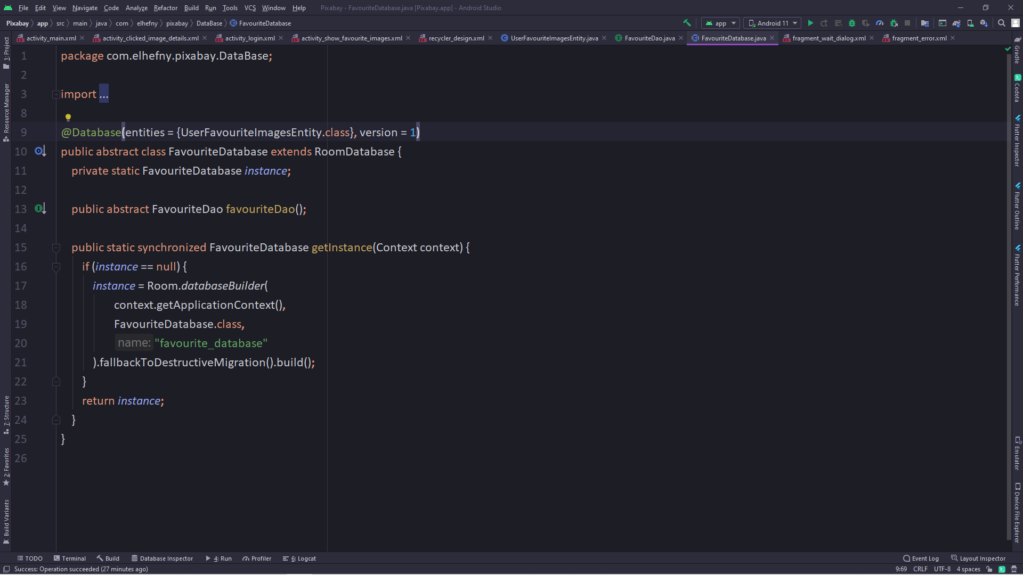
Rome Database
Here we define the version of the database and the classes we define as the tables to be stored on the device.

Slide 13
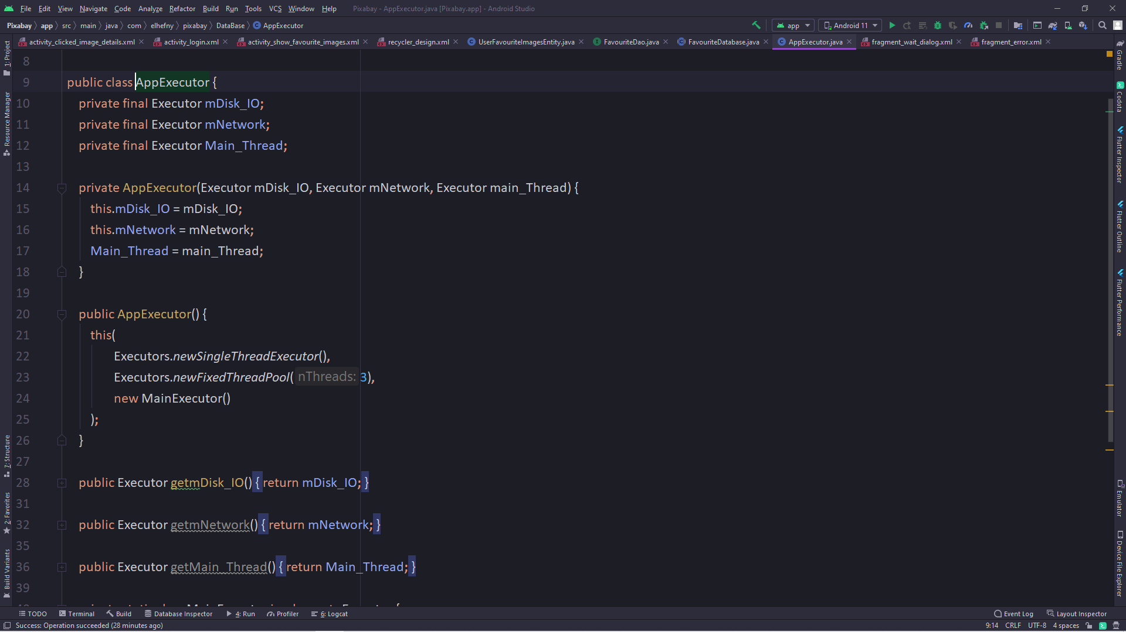
Executor
Rome Database use Background thread to access the data so we use three thread one for the disk input and output ‘database’
The second for Internet the third is the main thread

Slide 14
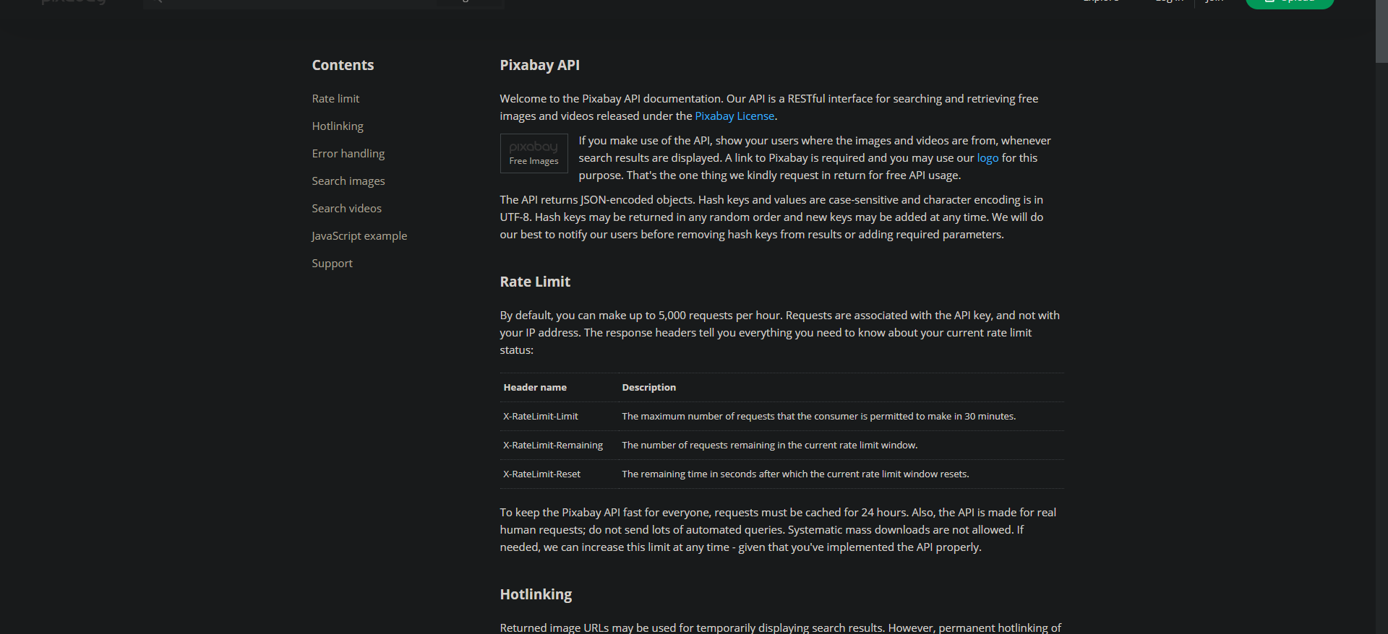
We use Pixabay API to get the images from the server
https://pixabay.com/api/docs/

Slide 15
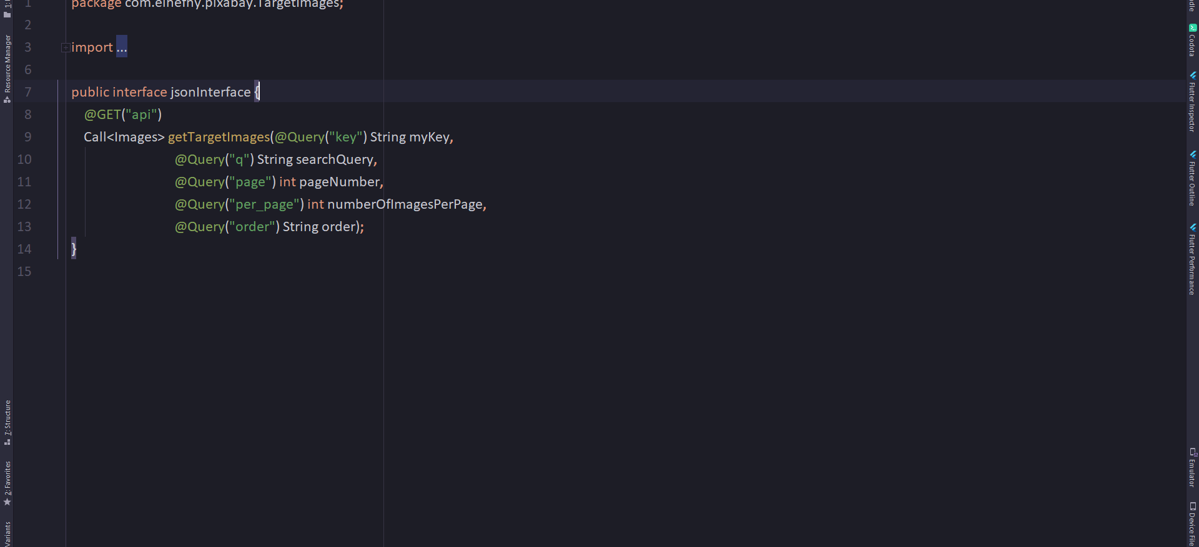
That will call the server to get images form the server
Class Image will get all data.

Slide 16
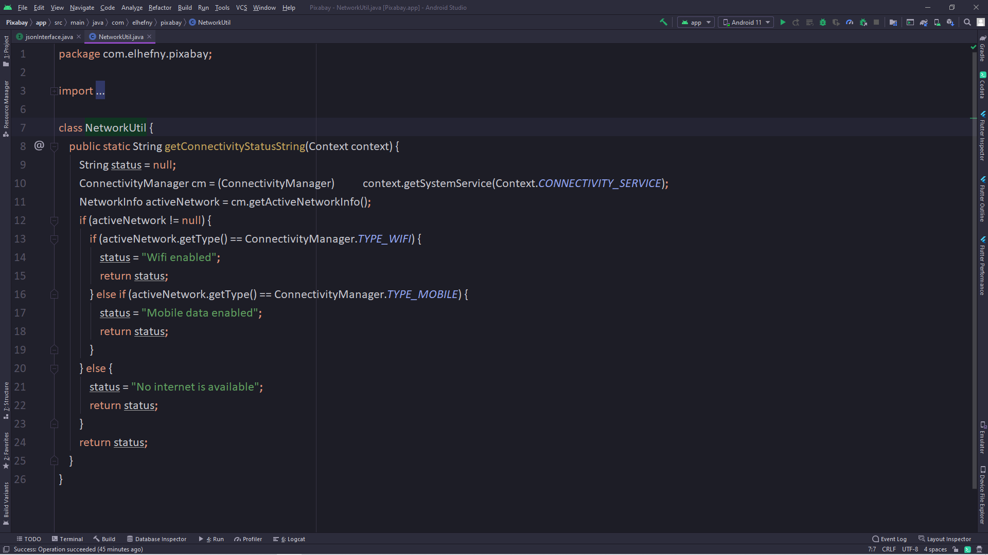
Check The Network

Slide 17
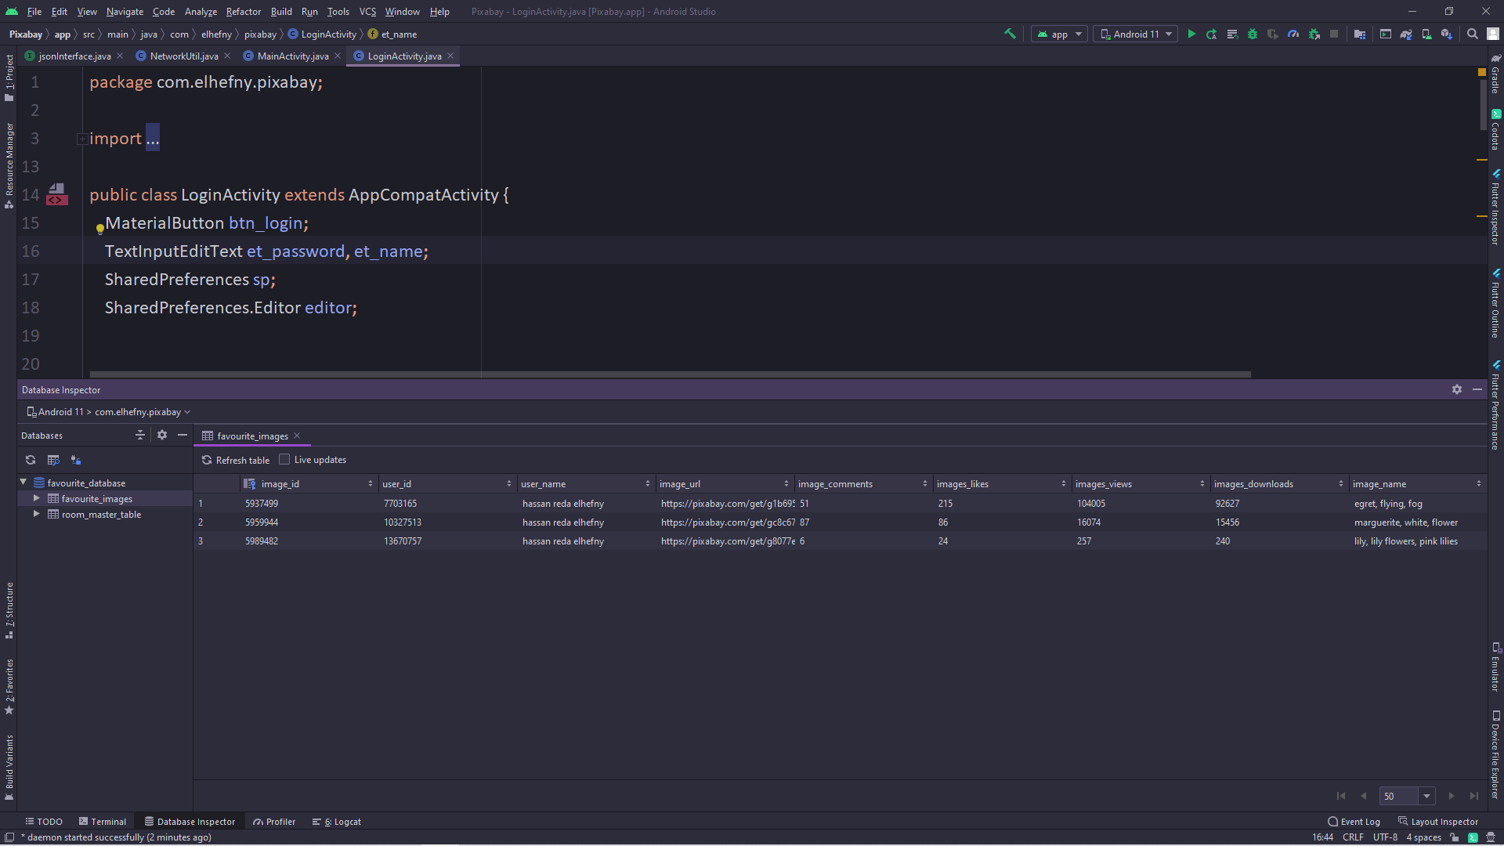
Database Table

Slide 18
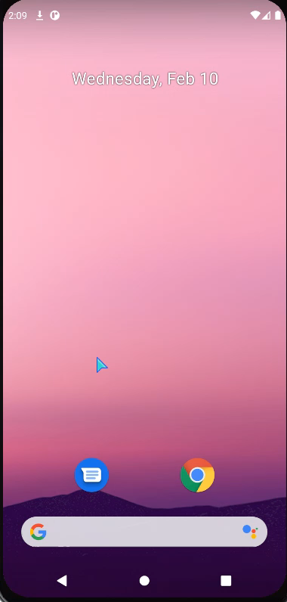
The Over View of The Application
This video describe the scenario of how the application work

